Slide 1



Slide 2
Forecast
Consists of two words “Fore” (before) and “Cast” (to project)
A statement about the future value of a variable of interest
Forecasts are the basis for budgeting, planning capacity, sales, production and inventory, personnel, purchasing etc.

Slide 3
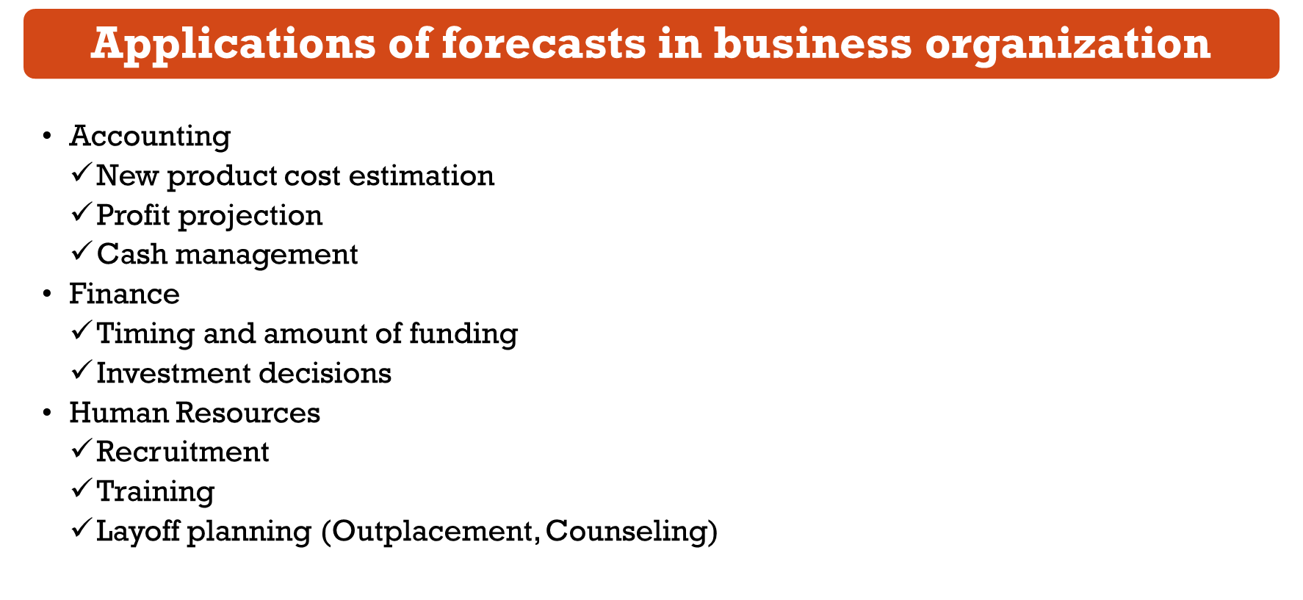
Marketing
  Pricing and promotion
  Global competition strategies
Operations
  Schedules
  Work assignments and workloads
  Inventory Planning
  Make or buy decisions
  Outsourcing
Product/Service design
  Revision of current features
  Design of new products and services

Slide 4
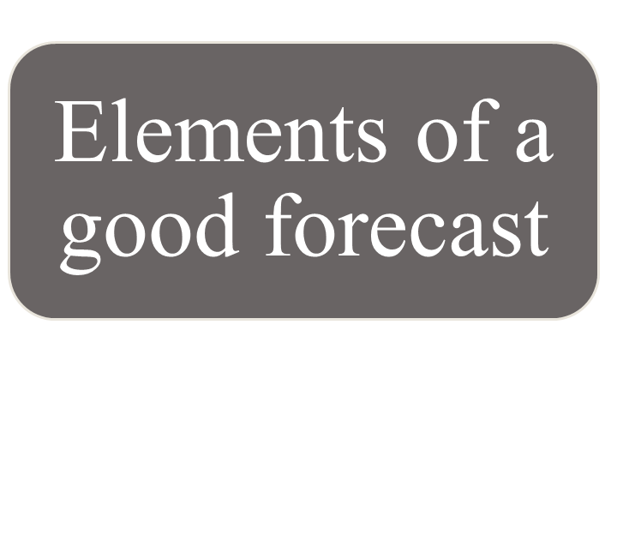
Timely
Accurate
Consistent
Meaningful units
In written form
Simplicity

Slide 5
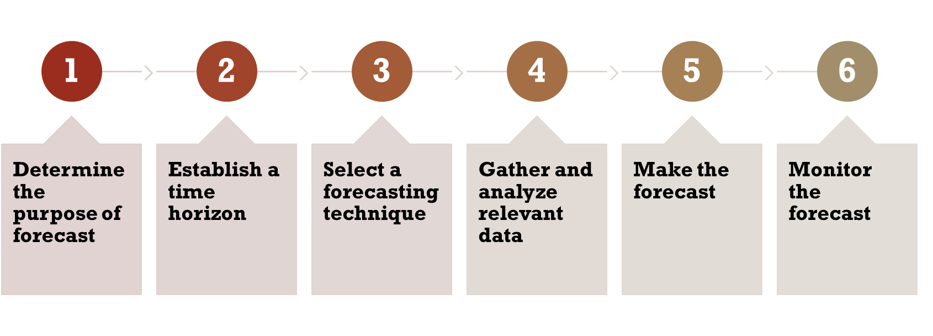
Steps in the forecasting process

Slide 6
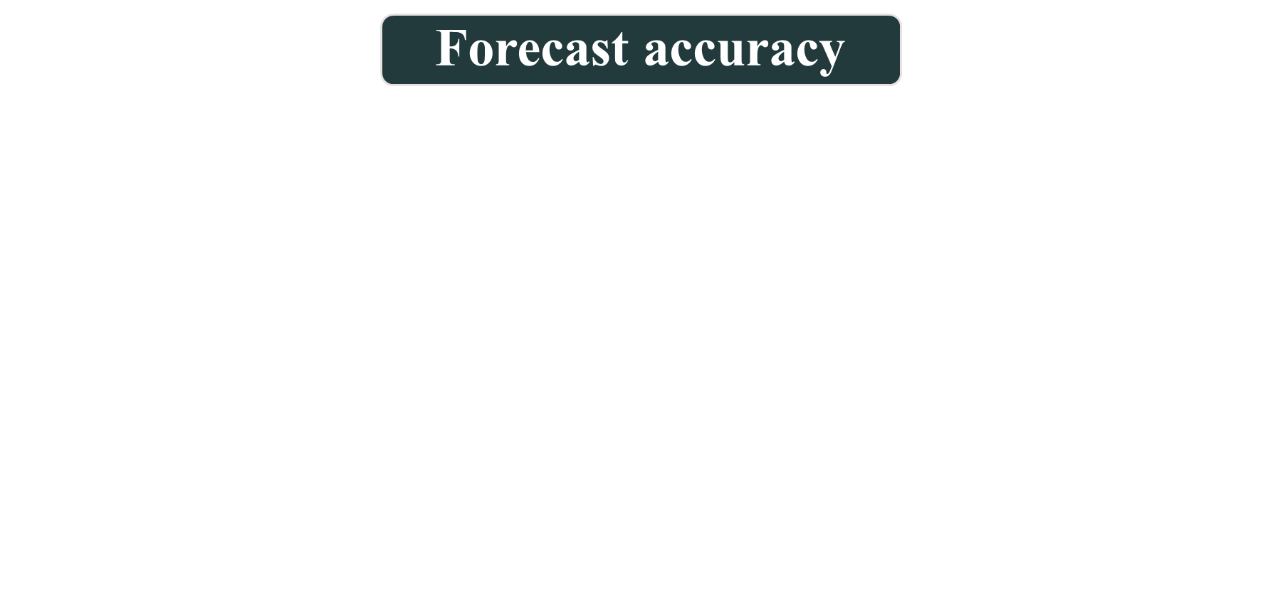
The complex nature of most real-world variables makes it almost impossible to correctly predict future values of those variables on a regular basis.
Because random variation is always present, there will always be some residual error, even if all other factors have been accounted for.
Decision makers will want to include accuracy as a factor when choosing among different techniques, along with cost.
Some forecasting applications involve a series of forecasts (e.g., weekly revenues), whereas others involve a single forecast that will be used for a one-time decision (e.g., the size of a power plant)
When making periodic forecasts, it is important to monitor forecast errors to determine if the errors are within reasonable bounds. If they are not, it will be necessary to take corrective action.

Slide 7
Approaches to forecasting
There are two general approaches to forecasting:
Qualitative forecasting techniques
  consist mainly of subjective inputs
  often defy precise numerical description
  permit inclusion of soft information (e.g., human factors, personal opinions, hunches) in the forecasting process
Quantitative forecasting techniques
  involve either the projection of historical data or the development of associative models that attempt to utilize causal (explanatory) variables to make a forecast
  consist mainly of analyzing objective, or hard data
  avoid personal biases that sometimes contaminate qualitative methods

Slide 8
Typical forecasting techniques
Judgmental forecasts
  rely on analysis of subjective inputs obtained from various sources, such as consumer surveys, the sales staff, managers and executives, and panels of experts
  Quite frequently, these sources provide insights that are not otherwise available
Time-series forecasts
  simply attempt to project past experience into the future
  these techniques use historical data with the assumption that the future will be like the past
  some models identify specific patterns in the data and project or extrapolate those patterns into the future, without trying to identify causes of the patterns
Associative models
  use equations that consist of one or more explanatory variables that can be used to predict demand
  demand for paint might be related to variables such as the price per gallon and the amount spent on advertising, as well as to specific characteristics of the paint (e.g., drying time, ease of cleanup)

Slide 9
Qualitative techniques
Executive opinions
  a small group of upper-level managers (e.g., in marketing, operations, and finance) may meet and collectively develop a forecast
  this approach is often used as a part of long-range planning and new product development
  there is the risk that the view of one person will prevail, and the possibility that diffusing responsibility for the forecast over the entire group may result in less pressure to produce a good forecast
Salesforce opinions
  members of the sales staff or the customer service staff are often good sources of information because of their direct contact with consumers
  staff members may be unable to distinguish between what customers would like to do and what they actually will do
  staff members are sometimes overly influenced by recent experiences
Consumer surveys
  organizations seeking consumer input usually resort to consumer surveys, which enable them to sample consumer opinions
  The obvious advantage of consumer surveys is that they can tap information that might not be available elsewhere

Slide 10
Qualitative techniques
Consumer surveys
  skill is required to construct a survey, administer it, and correctly interpret the results for valid information
  Surveys can be expensive and time-consuming
Other approaches
  Delphi method
    an iterative process in which managers and staff complete a series of questionnaires, each developed from the previous one, to achieve a consensus forecast
    the Delphi method is useful for technological forecasting, that is, for assessing changes in technology and their impact on an organization
    often the goal is to predict when a certain event will occur

Slide 11
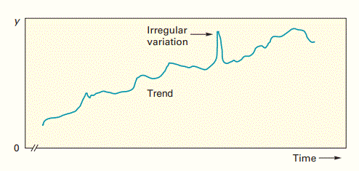
Forecasts based on time series data
A time series is a time-ordered sequence of observations taken at regular intervals (e.g., hourly, daily, weekly, monthly, quarterly, annually)
Trend
  refers to a long-term upward or downward movement in the data
  Population shifts, changing incomes, and cultural changes often account for such movements

Slide 12
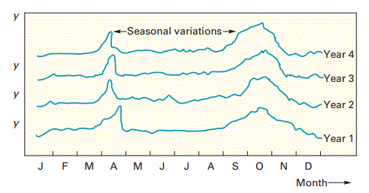
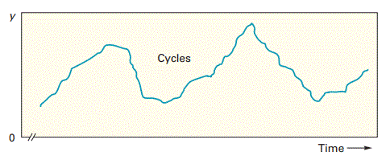
Forecasts based on time series data
Seasonality
  refers to short-term, fairly regular variations generally related to factors such as the calendar or time of day
  Restaurants, supermarkets, and theaters experience weekly and even daily “seasonal” variations
Cycles
  are wavelike variations of more than one year’s duration
  These are often related to a variety of economic, political, and even agricultural conditions

Slide 13
Forecasts based on time series data
Irregular variations
  are due to unusual circumstances such as severe weather conditions, strikes, or a major change in a product or service
  they do not reflect typical behavior, and their inclusion in the series can distort the overall picture
  Whenever possible, these should be identified and removed from the data
Random variations
  are residual variations that remain after all other behaviors have been accounted for

Slide 14
Techniques for averaging
Averaging techniques smooth variations in the data.
Ideally, it would be desirable to completely remove any randomness from the data and leave only “real” variations, such as changes in the demand.
Averaging techniques smooth fluctuations in a time series because the individual highs and lows in the data offset each other when they are combined into an average.
A forecast based on an average thus tends to exhibit less variability than the original data.
responding to changes in expected demand often entails considerable cost (e.g., changes in production rate, changes in the size of a workforce, inventory changes).
larger variations are viewed as
more likely to reflect “real” changes, although these, too, are smoothed to a certain degree

Slide 15
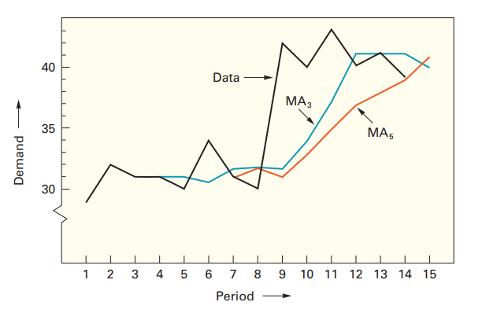
Techniques for averaging

Slide 16
Techniques for averaging
Three techniques for averaging are described in this section:
1. Moving average.
Technique that averages a number of recent actual values, updated as new values become available
2. Weighted moving average.
  More recent values in a series are given more weight in computing a forecast
3. Exponential smoothing.
Exponential smoothing is a sophisticated weighted averaging method that is still relatively easy to use and understand.

Slide 17
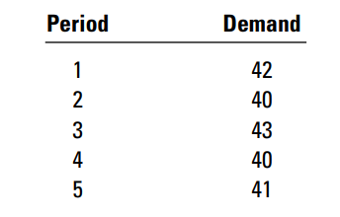
Compute a weighted average forecast using a weight of .40 for the most recent period, .30
for the next most recent, .20 for the next, and .10 for the next.

Slide 18
Forecast error
Forecast error is the difference between the value that occurs and the value that was predicted for a given time period. Hence, Error = Actual – Forecast
e_{t} = A_{t} – F_{t}
Where, t =Any given time period
Three commonly used measures for summarizing historical errors:
Mean absolute deviation (MAD)
Mean squared error (MSE)
Mean absolute percent error (MAPE)

Slide 19
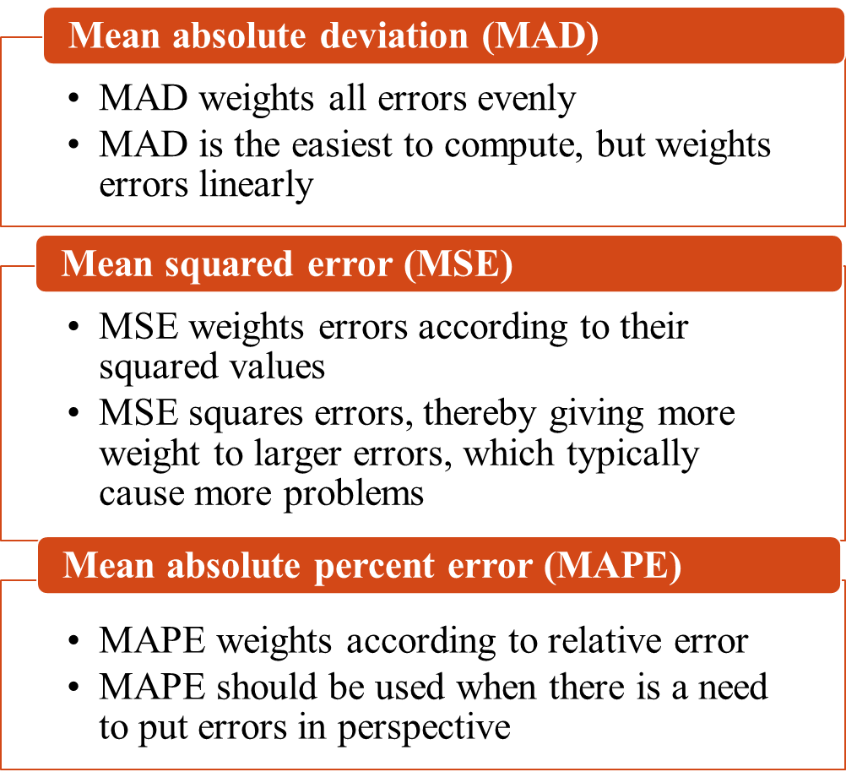
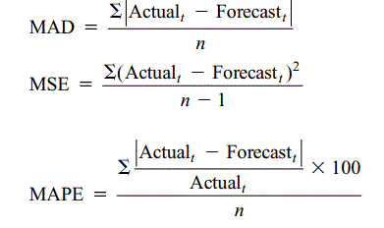
Forecast error

Slide 20
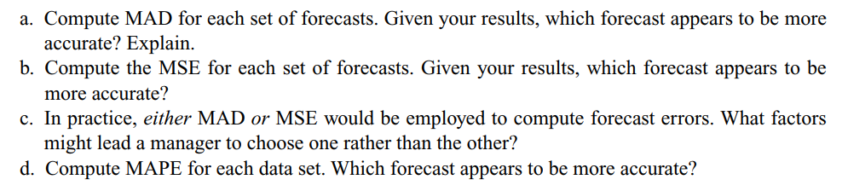
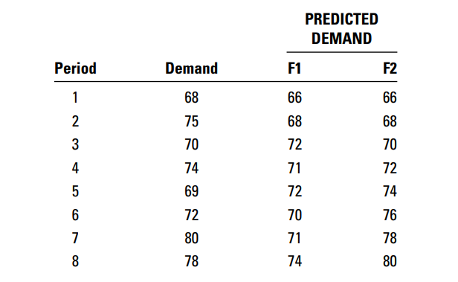

Slide 21
Monitoring the forecast
Control chart A visual tool for monitoring forecast errors.
A very useful tool for detecting non-randomness in errors.
Errors are plotted on a control chart in the order that they occur.
Basic elements of control chart
  Center Line (CL)
  Upper Control Limit (UCL)
  Lower Control Limit (LCL)

Slide 22
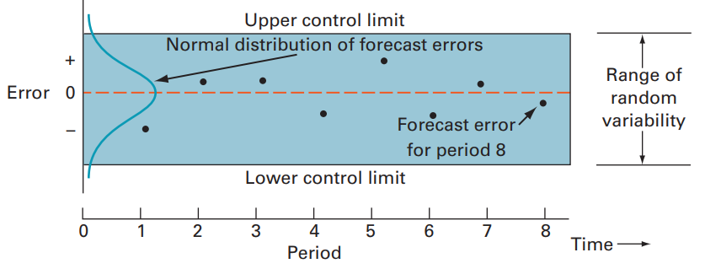
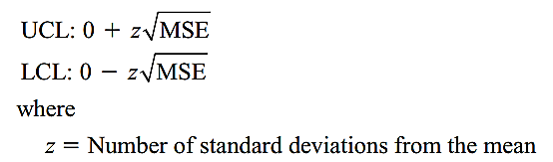

Fig: Control chart

Slide 23
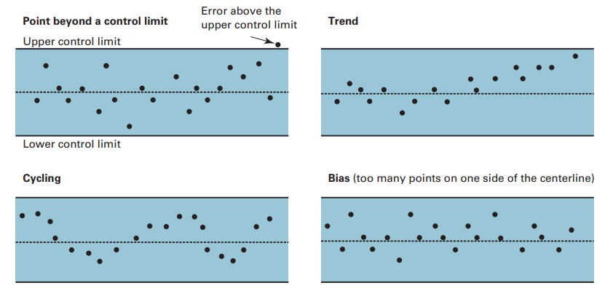
Fig: Non randomness in control chart

Slide 24
Associative forecasting technique
Predictor variables Variables that can be used to predict values of the variable of interest.
Regression Technique for fitting a line to a set of points.
Least squares line Minimizes the sum of the squared vertical deviations around the line.

Slide 25
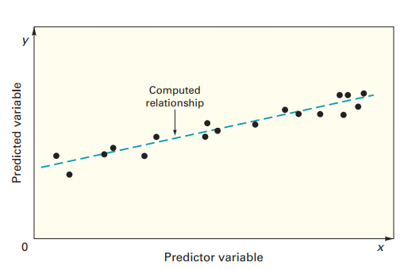
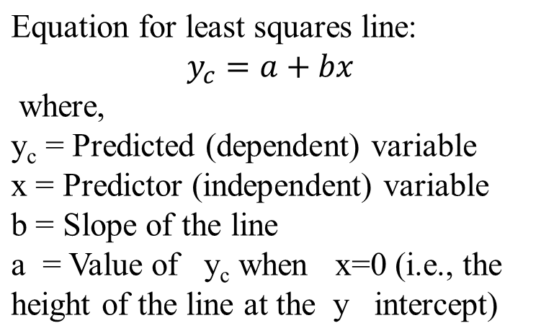
Associative forecasting technique

Slide 26
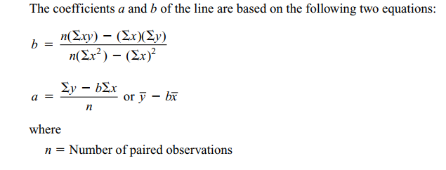
Associative forecasting technique

Slide 27
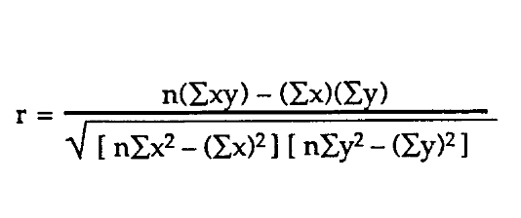
Associative forecasting technique
Correlation A measure of the strength and direction of relationship between two variables.
Correlation can range from + 1.00 to -1.00.
The correlation between two variables can be computed using the equation
The square of the correlation coefficient, r² , provides a measure of the percentage of variability in the values of y that is “explained” by the independent variable.
The possible values of r² range from 0 to 1.00.
The closer r² is to 1.00, the greater the percentage of explained variation.

Slide 28

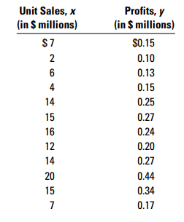

Slide 29
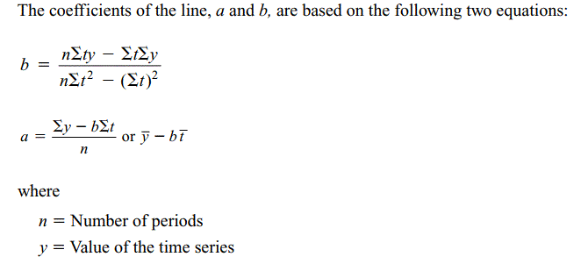
Linear trend equation

Slide 30
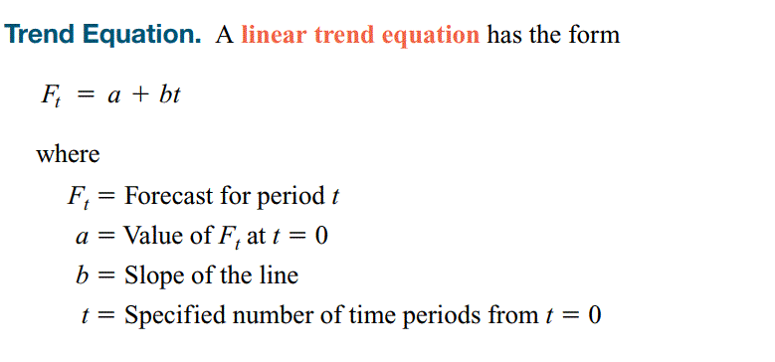
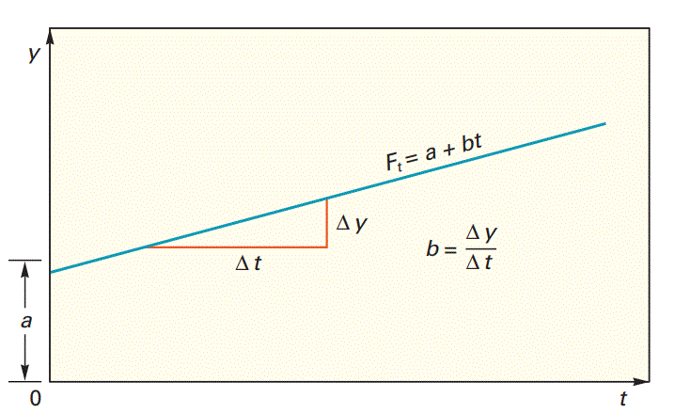
Linear trend equation

Slide 31

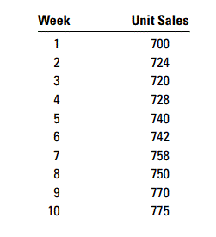
Linear trend equation

Slide 32
Naïve methods
A forecast for any period that equals the previous period’s actual value.
The naive approach can be used with a stable series (variations around an average), with seasonal variations, or with trend
with a stable series, the last data point becomes the forecast for the next period
With seasonal variations, the forecast for this “season” is equal to the value of the series last “season.”
for data with trend, the forecast is equal to the last value of the series plus or minus the difference between the last two values of the series.
Advantages of naïve method:
It has virtually no cost
It is quick and easy to prepare because data analysis is nonexistent
It is easily understandable

